Slide 1
Module-1 Interactive Software and Interaction Device

Slide 2
Keywords:
Interactive Software and Interaction Device
Adaptive vs Responsive
UX vs UI

Slide 3
Importance of User Interface Design
Job Opportunities
Salary
Skills need to be developed
HTML
CSS
Javascript
Bootstrap
Angular.js
jQuery
Github
Sass
UI Frameworks
Adobe Photoshop
Sketch
Invision
Figma
Adobe XD

Slide 4
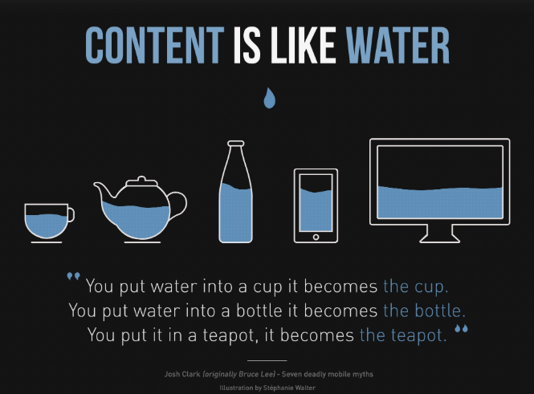

Slide 5
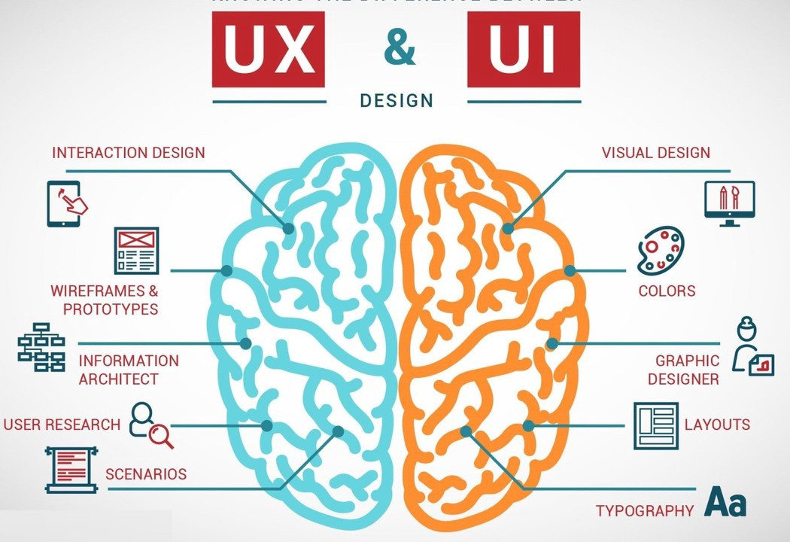
User Interface vs User Experience

